Slide 1
Numerical Analysis
Newton Method
Lab8
Gp Capt® Umar Farooq
&
Demonstrator Kabeer Ahmed
MCS and MS Telecommunication Network

Slide 2
Function with two return values
Define a function in Q7P96.m file or use as sub function
  function [y,dy]=Q7P96(x)
  y=x*exp(-x);
  dy=-x*exp(-x)+exp(-x);
[fv,dfv]=feval('Q7P96',.2)

Slide 3
Newton Method
Write a program to approximate root of equation f(x)=0 in the vicinity of p₀ using Newton method newton.m
Input
- f is the function
- p₀ is the initial approximation
- delta is the tolerance for increment
- max1 is the maximum number of iterations
Output
k is the number of iteration
p₀ is the Newton approximation to the zero
inc is the final value of f(p₀)/f’(p₀)
err is the error estimate for p₀
y is the value of function at p₀ i.e. f(p₀)

Slide 4
Newton Method
Newton function prototype
function [k,p0,inc,err,y] = newton(f,p0,delta,max1)
Formula to calculate the value of next number in the sequence
inc=fv/dfv;
p0=p0-inc; y=fv;
Condition with dalta
abs(inc)<delta

Slide 5
Example 1
Define a function in Q7P96.m file
  function [y,dy]=Q7P96(x)
  y=x*exp(-x);
  dy=-x*exp(-x)+exp(-x);
Draw the graph of f(x)=x*exp(-x) in command window.
>> fplot('Q7P96', [0 2*pi])
>>grid on
The root is lying in the vicinity of 0

Slide 6
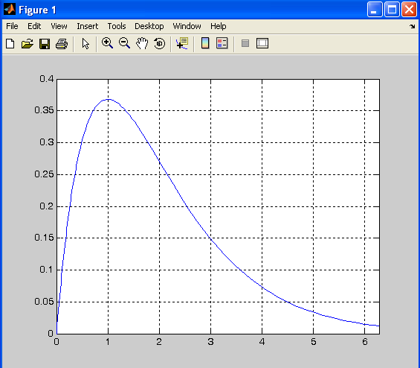

Slide 7
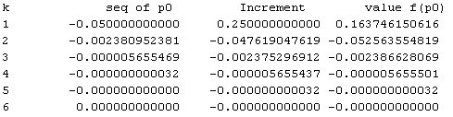
Example 1
>> [k,p0,inc,y] = newton('Q7P96',.2,1e-11,100)
k = 6
p0 =0
inc = -1.022983310832279e-021
y = -1.022983310832279e-021

Slide 8
Practice Question
Question 3
newtonsqa.m

Slide 9
Assignment
Question 4
Submission Date 14-04-2010
1000 hrs
at
\\csdept\data\Assignments\Mr. Kabeer Ahmed\BESE14A

